Slide 1
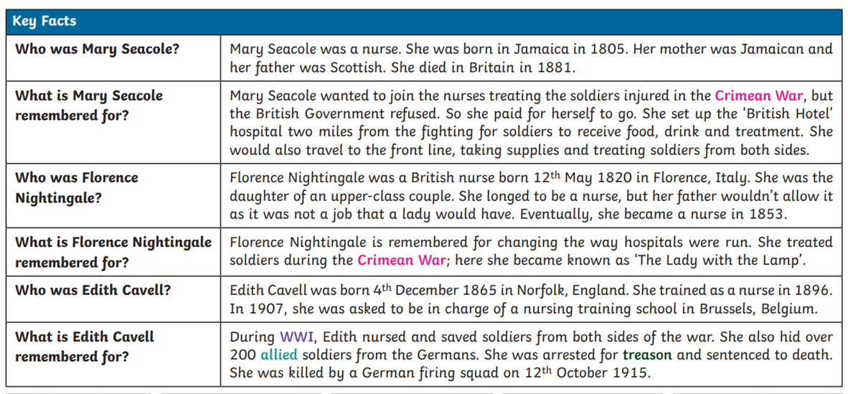
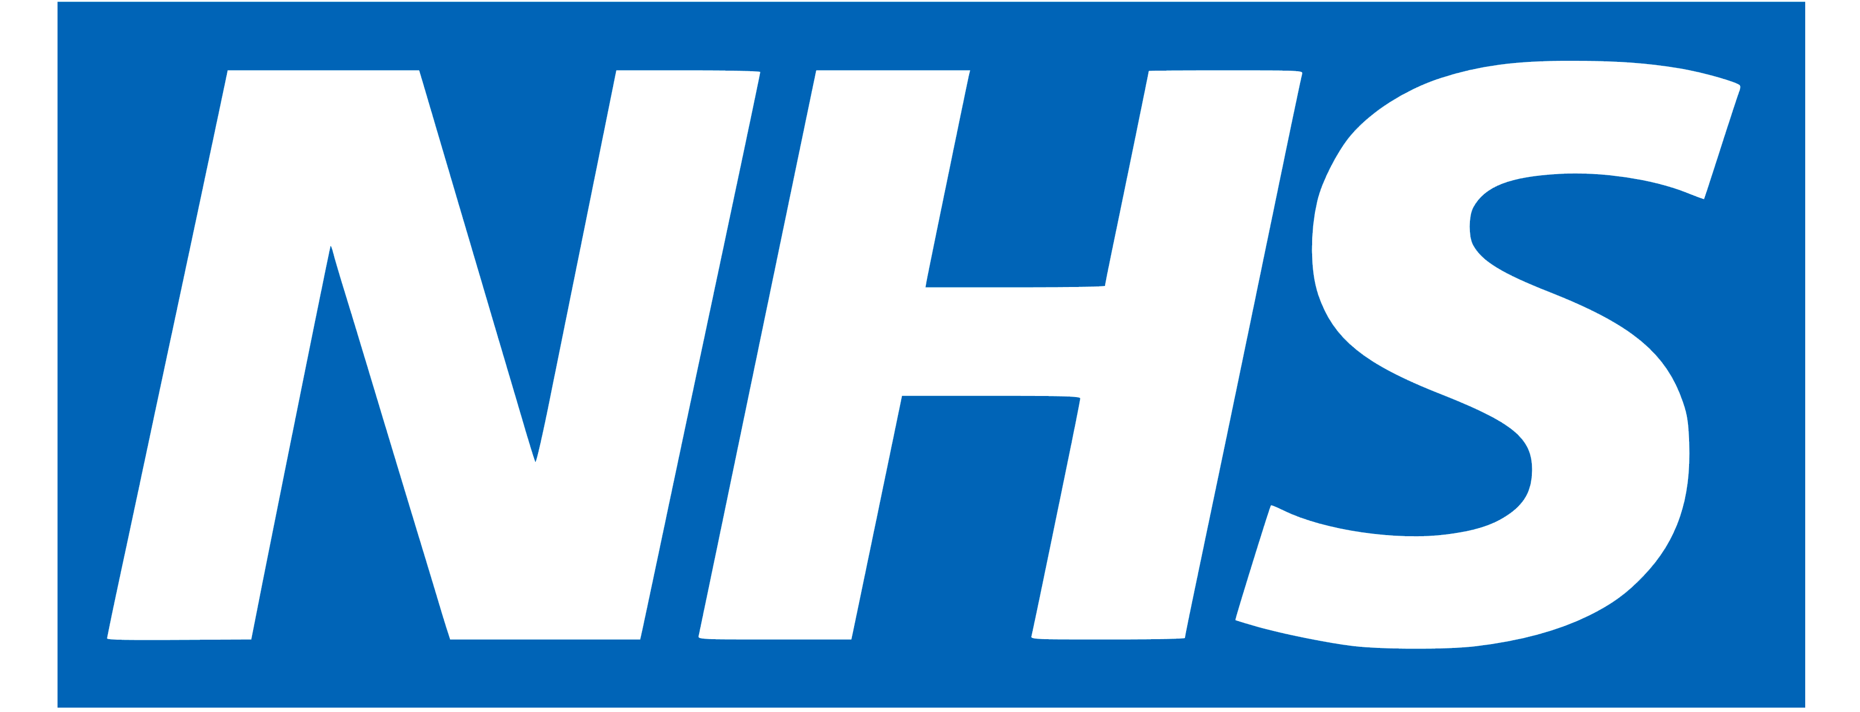
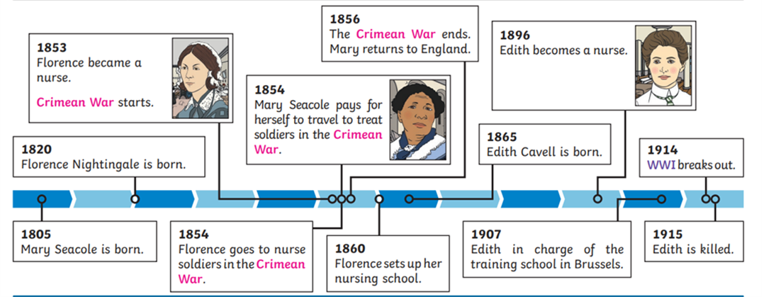
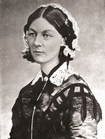
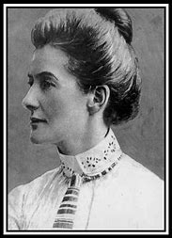
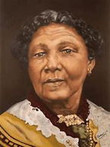
Nurturing
Nurses
Key Vocabulary
Crimean war | The Crimean War was a military conflict fought from October 1853 to February 1856 in which Russia lost to an alliance of France, the Ottoman Empire, the United Kingdom and Piedmont-Sardinia. Florence Nightingale and Mary Seacole both nursed soldiers during this war.
WWI | World War I was a major conflict fought between 1914 and 1918.
Allies | Countries that fight together against other countries. In the First World War, the allies were Britain, France, Russia and USA
Nurse | a person trained to care for the sick or infirm, especially in a hospital.
Scutari hospital | During the Crimean War Scutari Barracks was converted into a British military hospital, known as Scutari Hospital. Florence Nightingale became famous for her work in a hospital in Scutari.
NHS | The NHS stands for the National Health Service. It refers to the Government-funded medical and health care services that everyone living in the UK can use without being asked to pay the full cost of the service

